Slide 1
DAV_21092483
File created on: 07/04/2023 12:50:56 PM GMT+01:00

Slide 2
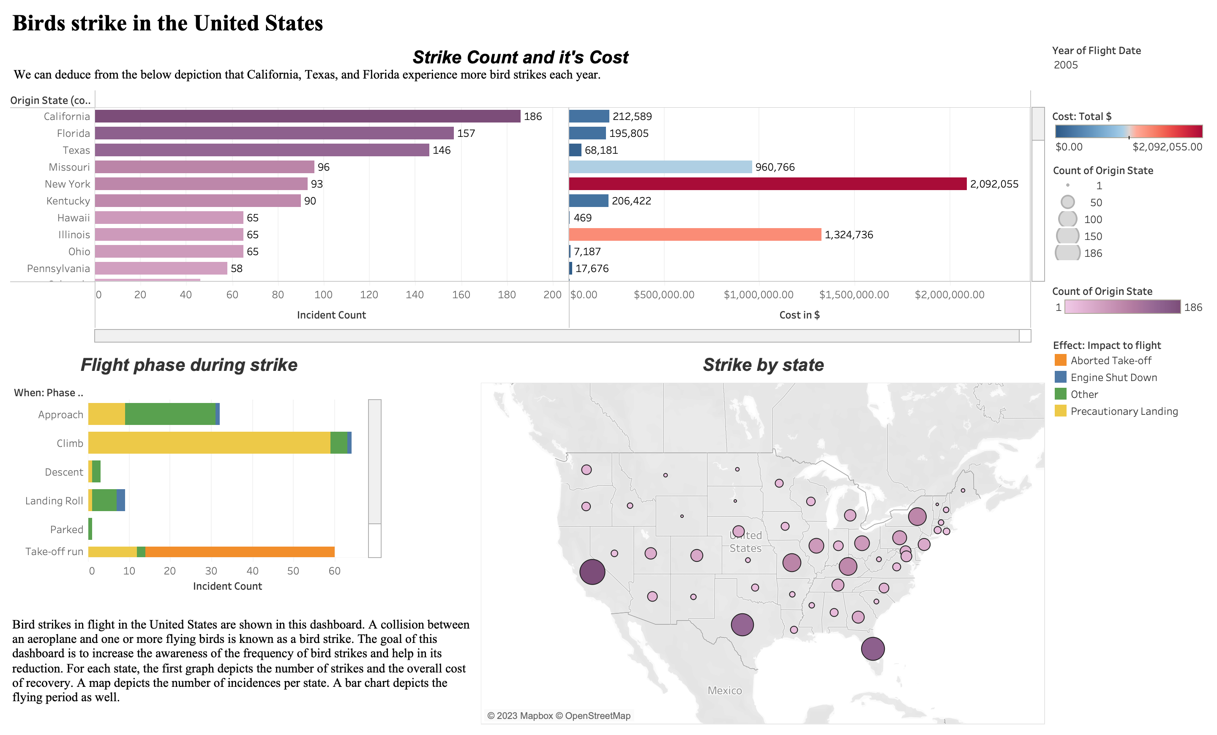

Slide 3
